Slide 1

SSID: WWCode
Password: password

Slide 2


Machine Learning and AI Study Group
Twitter: @wwcodemanila
FB: fb.com/wwcodemanila

Slide 3
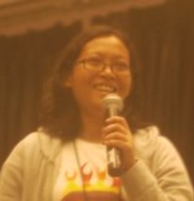
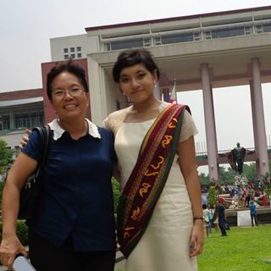
Issa Tingzon
Research Fellow
Philippine-California Advanced Research Institutes
Notes:
Please use only the three colors for the content.

Slide 4
New Member’s Introduction

Slide 5

I am <name>
<your current profession>
<why did you join this study group?>
Notes:
Please use only the three colors for the content.

Slide 6
SHOW & TELL
(Handwritten Digit Recognition)
Notes:
Please use only the three colors for the content.

Slide 7
Study Groups
Study Group 1: Machine Learning Basics
Study Group 2: Data Preprocessing (Part 1)
Notes:
Please use only the three colors for the content.

Slide 8
AGENDA
1. Quick Review: Intro to Machine Learning
2. New Topic: Data Preprocessing
3. Exercise
4. Presentations
Notes:
Please use only the three colors for the content.

Slide 9
REVIEW
Notes:
Please use only the three colors for the content.

Slide 10
Intro to Machine Learning
1. Types of ML Algorithms:
- Supervised – KNOW about the data (Prediction, Classification)
- Unsupervised – DON’T KNOW about the data (Clustering, Association)
Notes:
Please use only the three colors for the content.

Slide 11
Intro to Machine Learning
2. Supervised Learning - Two main blocks:
- Training - take input X and corresponding labels y,
outputs learned model h
- Prediction – take NEW DATA as input, use h to output
corresponding predictions
Notes:
Please use only the three colors for the content.

Slide 12
Intro to Machine Learning
3. Testing a Machine Learning Algorithm:
Splitting your dataset:
- Training data (input to algorithm)
- Test data (evaluation only)
- General Splitting technique (80/20)
Notes:
Please use only the three colors for the content.

Slide 13
Intro to Machine Learning
4. Machine Learning Programming using Libraries:
1. Import the learning algorithm (from sklearn…)
2. Instantiate the model (clf = SomeClassifier())
3. Learn the model (clf.fit(…))
4. Predict response (clf.predict)
5. Evaluate model (clf.score())
Notes:
Please use only the three colors for the content.

Slide 14
Intro to Machine Learning
6. Our first machine learning project(s):
- Iris Plant Classification
- Handwritten Digit Recognition
- Bonus: Kaggle Submission
Notes:
Please use only the three colors for the content.

Slide 15
TODAY’S TOPIC
Data Pre-processing:
Feature Scaling
Notes:
Please use only the three colors for the content.

Slide 16
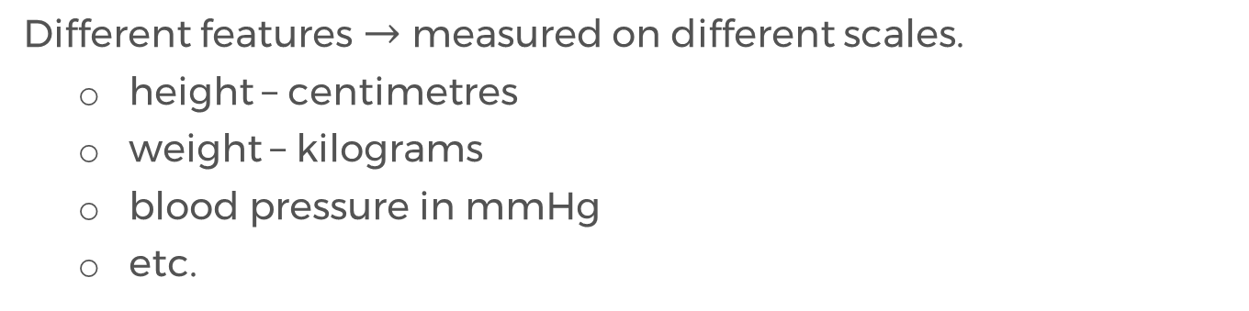
FEATURE SCALING
Different features $→$ measured on different scales.
height – centimetres
weight – kilograms
blood pressure in mmHg
etc.
Some classifiers combine and compare feature values (e.g. Euclidean distance).
Notes:
Please use only the three colors for the content.

Slide 17
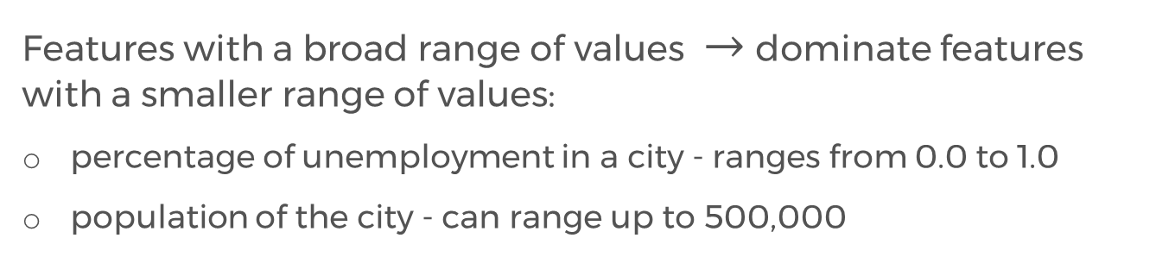
FEATURE SCALING
Features with a broad range of values $→$ dominate features with a smaller range of values:
percentage of unemployment in a city - ranges from 0.0 to 1.0
population of the city - can range up to 500,000
Scaling transforms the data so that the features have, more or less, uniform range.
Notes:
Please use only the three colors for the content.

Slide 18

Min-max Scaling
Computing the norm of feature vector $X:$
$$z_{i}=\frac{x_{i}−x_{min}}{x_{max} −x_{min}}$$
Example: For feature age:
$$z_{1}=\frac{22 −22}{42 −22}=0$$
ID | Age | Age_{scaled}
1 | 22 | 0.00
2 | 25
3 | 30
4 | 42
Notes:
Please use only the three colors for the content.

Slide 19

Min-max Scaling
Computing the norm of feature vector $X:$
$$z_{i}=\frac{x_{i}−x_{min}}{x_{max} −x_{min}}$$
Example: For feature age:
$$z_{2}=\frac{25 −22}{42 −22}=0.15$$
ID | Age | Age_{scaled}
1 | 22 | 0.00
2 | 25 | 0.15
3 | 30
4 | 42
Notes:
Please use only the three colors for the content.

Slide 20

Min-max Scaling
Computing the norm of feature vector $X:$
$$z_{i}=\frac{x_{i}−x_{min}}{x_{max} −x_{min}}$$
Example: For feature age:
$$z_{3}=\frac{30 −22}{42 −22}=0.4$$
ID | Age | Age_{scaled}
1 | 22 | 0.00
2 | 25 | 0.15
3 | 30 | 0.40
4 | 42
Notes:
Please use only the three colors for the content.

Slide 21

Min-max Scaling
Computing the norm of feature vector $X:$
$$z_{i}=\frac{x_{i}−x_{min}}{x_{max} −x_{min}}$$
Example: For feature age:
$$z_{4}=\frac{42 −22}{42 −22}=1$$
ID | Age | Age_{scaled}
1 | 22 | 0.00
2 | 25 | 0.15
3 | 30 | 0.40
4 | 42 | 1.00
Notes:
Please use only the three colors for the content.

Slide 22
Task: Read the Feature Scaling Tutorial
Notes:
Please use only the three colors for the content.

Slide 23
Partner/Group/Individual Exercise:
WINE DATA CLASSIFICATION
Note: Python beginners can partner up with more advanced users for better guidance
Notes:
Please use only the three colors for the content.

Slide 24
Partner/Group/Individual Presentation
Notes:
Please use only the three colors for the content.

Slide 25
Assignment
Binarize features in the Handwritten Digit Recognition Exercise
Notes:
No required

Slide 26
References:
WWCodeLondon Slides
http://scikit-learn.org/stable/modules/preprocessing.html
http://sebastianraschka.com/Articles/2014_about_feature_scaling.html
Notes:
Please use only the three colors for the content.

Slide 27
T.I.L.
SHARE IT!
In front!
On Twitter: @wwcodemanila
Or FB: fb.com/wwcodemanila
Don’t forget to tag WWCodeManila so we can retweet or share it.
Notes:
Please use only the three colors for the content.

Slide 28
THANK YOU :)
Notes:
Please use only the three colors for the content.

